Slide 1
Lecture Jan 31,2011 Winter 2011
ECE 162B
Fundamentals of Solid State Physics
Band Theory and Semiconductor Properties
Prof. Steven DenBaars
ECE and Materials Depts
Solid State Lighting & Display Center
University of California Santa Barbara, USA

Slide 2
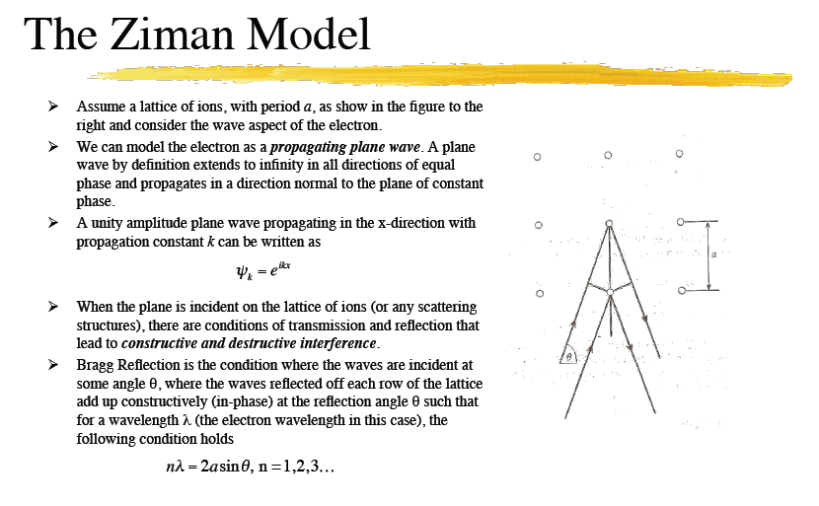

Slide 3
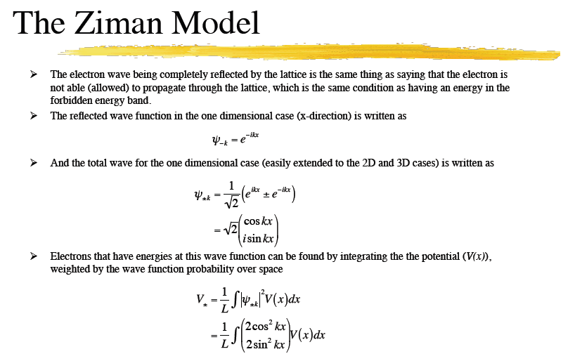

Slide 4
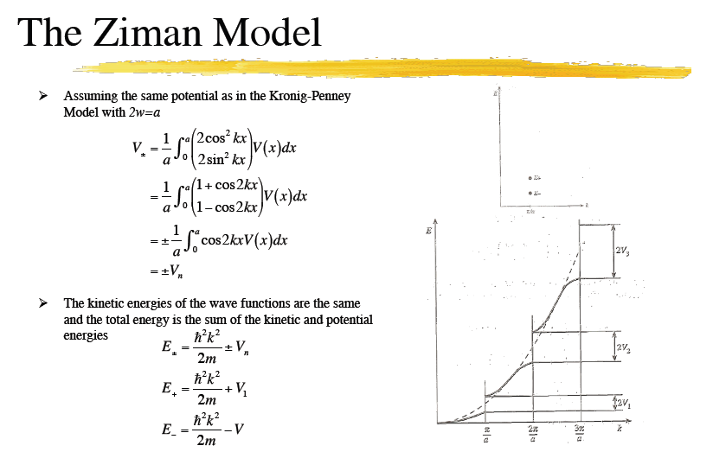

Slide 5
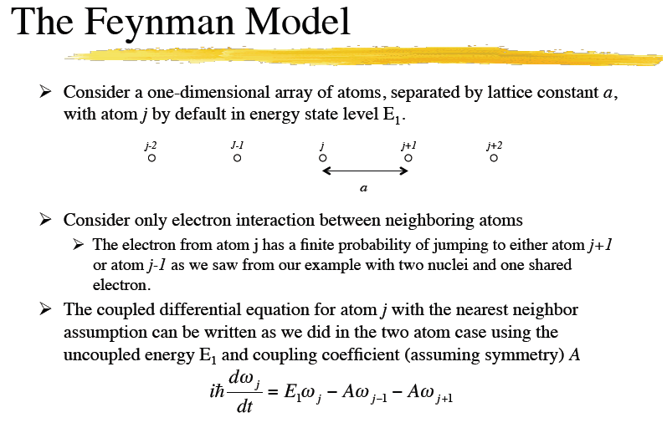

Slide 6
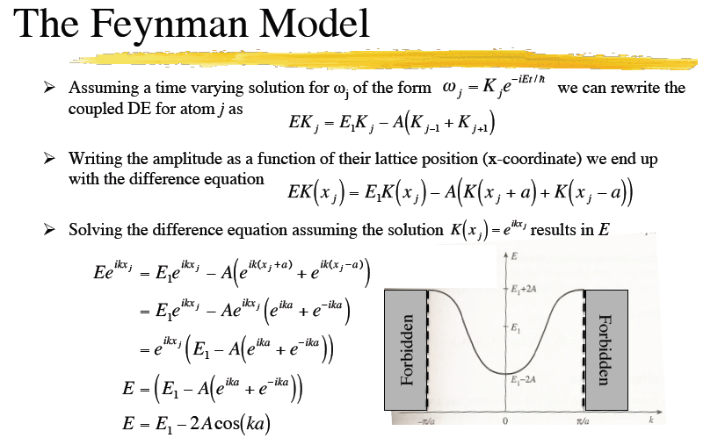

Slide 7
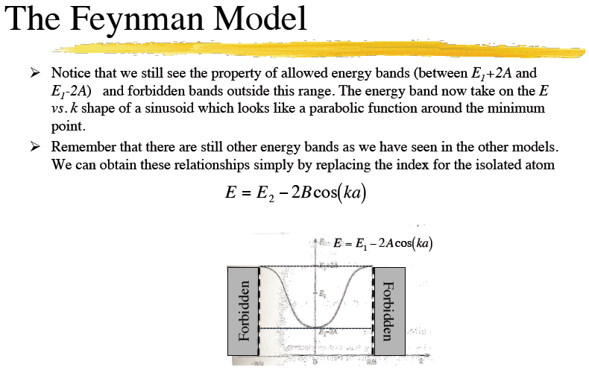

Slide 8
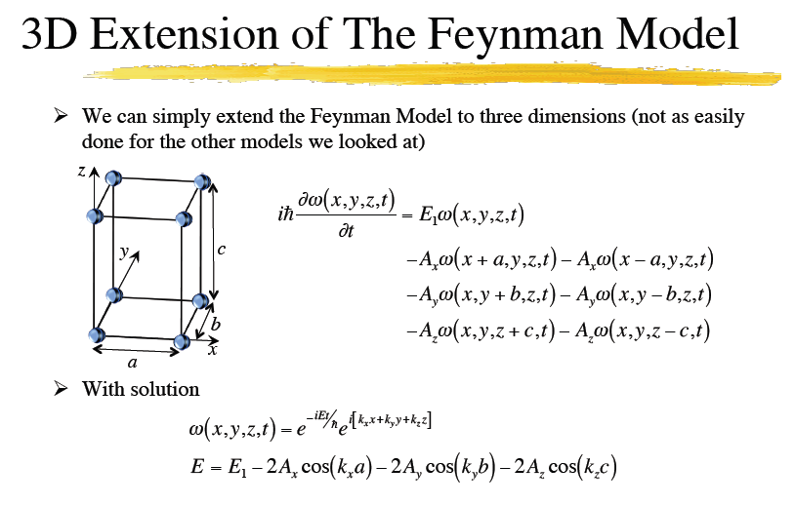

Slide 9
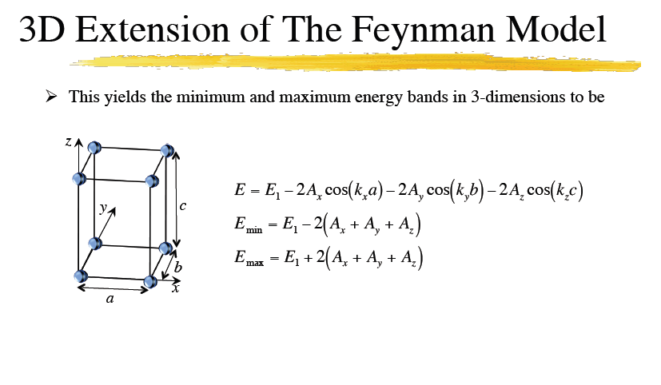

Slide 10
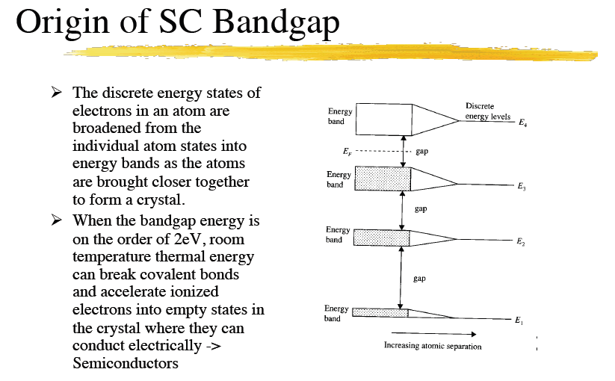

Slide 11
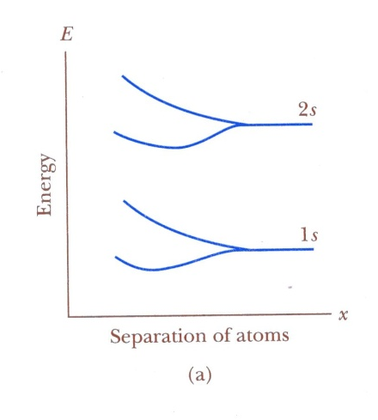
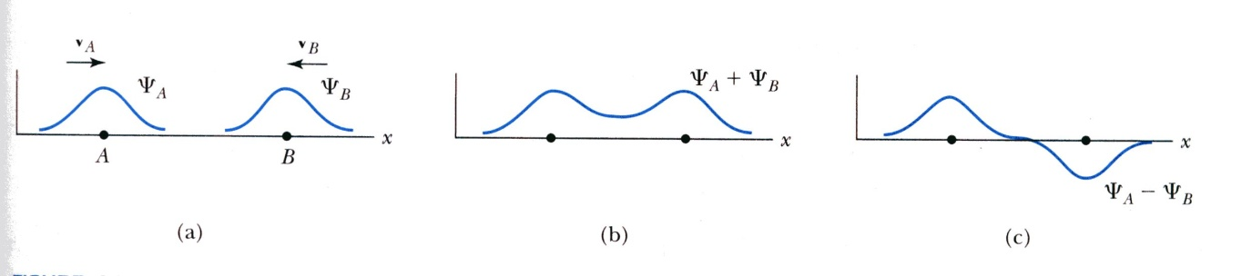
Energy Bands
—What will happen when two isolated atoms (e.g., H) are brought together?
Wave functions
Energy levels
The formation of new bonding and antibonding orbitals.
Energy degeneracy is broken→the splitting of energy level 1s and 2s
The lowering of energy of the bonding state gives rise to the cohesion of the system.
These results can be obtained by solving the Schrödinger equation with the LCAO
approximation. LCAO →liner combination of atomic orbitals.

Slide 12
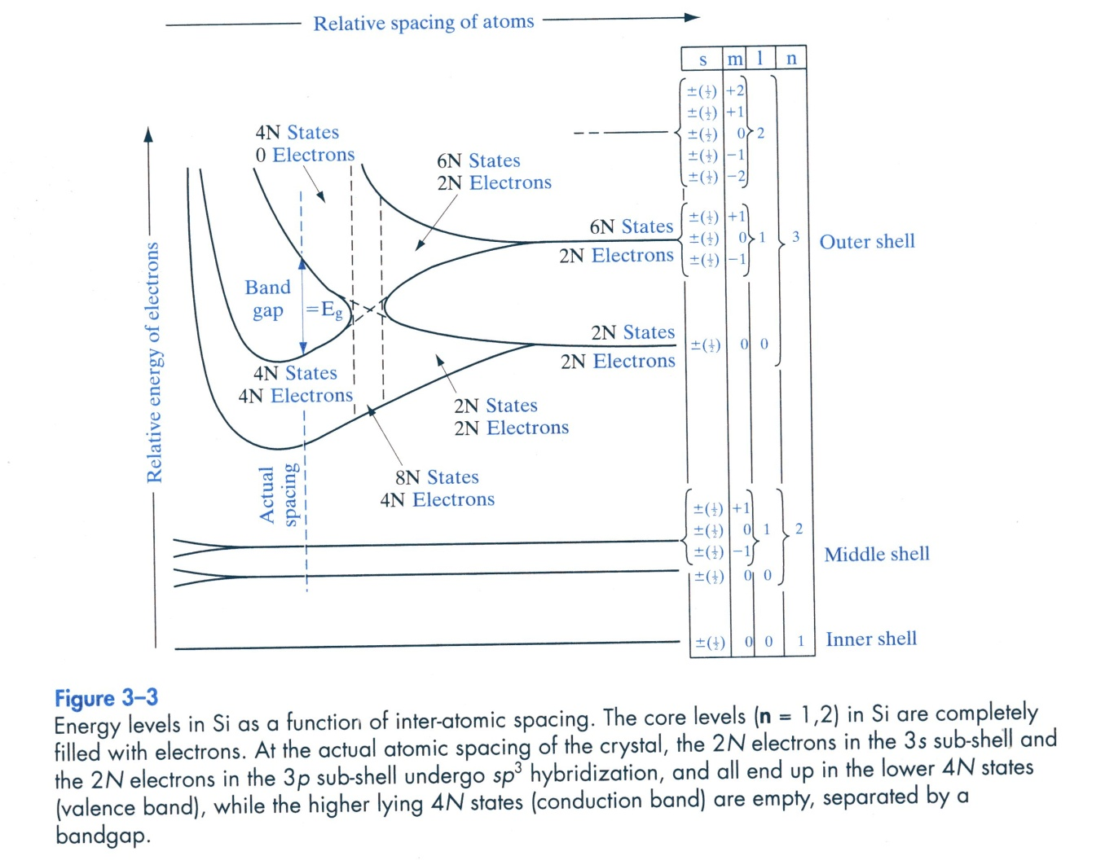
—What will happen when many (N) Si atoms are brought together to form a solid?
Energy bands are formed
Conduction band
Valence band
Forbidden band (band gap E_{g})
Electronic configuration of Si 1s²2s²2p⁶3s²3p²

Slide 13
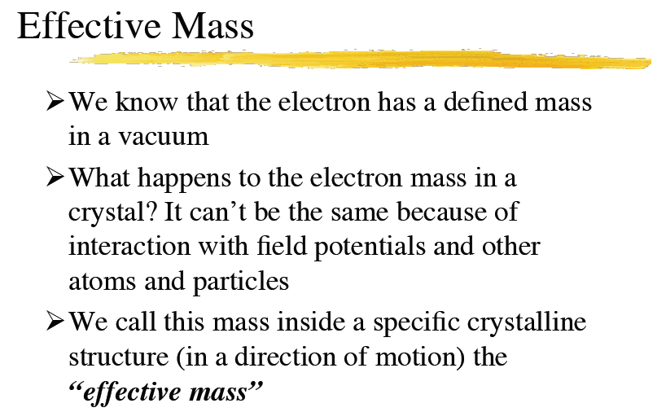

Slide 14
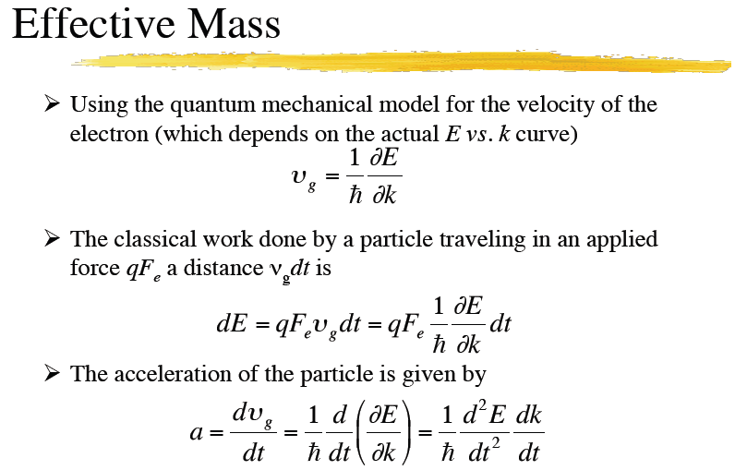

Slide 15
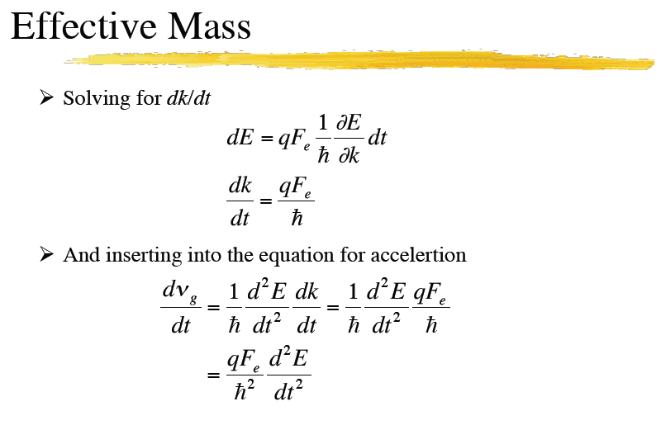

Slide 16
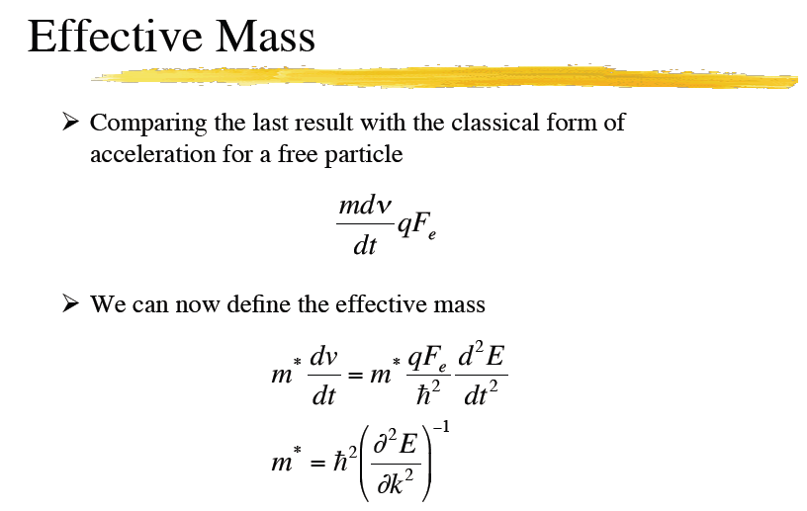

Slide 17
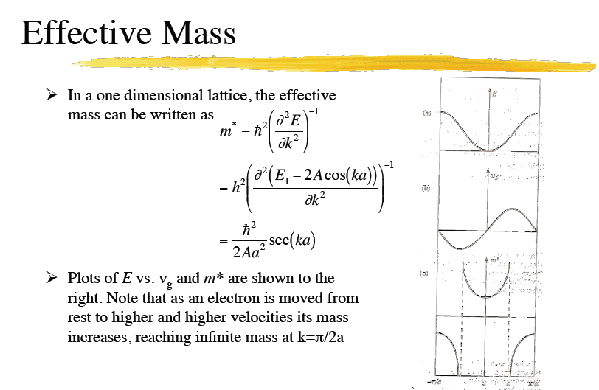

Slide 18
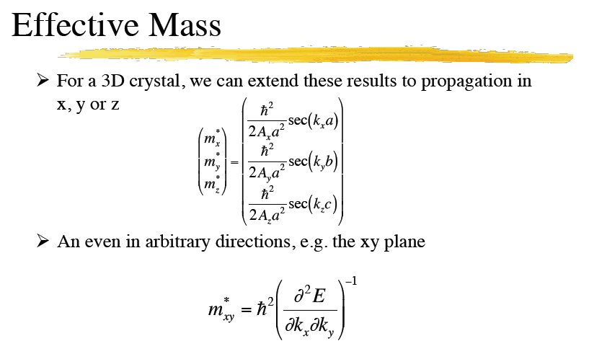

Slide 19
Semiconductor Properties
Chap 8 Solymar and Walsh

Slide 20
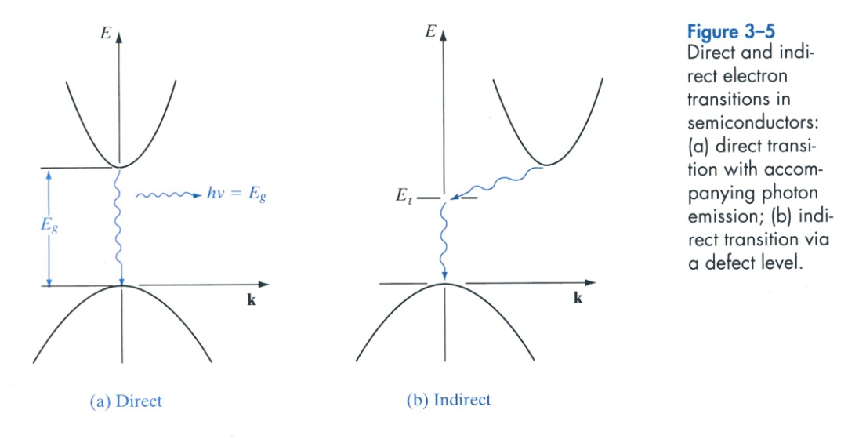
Direct and Indirect Semiconductors
The real band structure in 3D is calculated
with various numerical methods, plotted as
E vs k. k is called wave vector
For electron transition, both E and p (k) must
be conserved.
A semiconductor is direct if the maximum
of the conduction band and the minimum
of the valence band has the same k value
A semiconductor is indirect if the …do
not have the same k value
Direct semiconductors are suitable for
making light-emitting devices, whereas
the indirect semiconductors are not.
See Appendix III for more
data on semiconductor materials

Slide 21
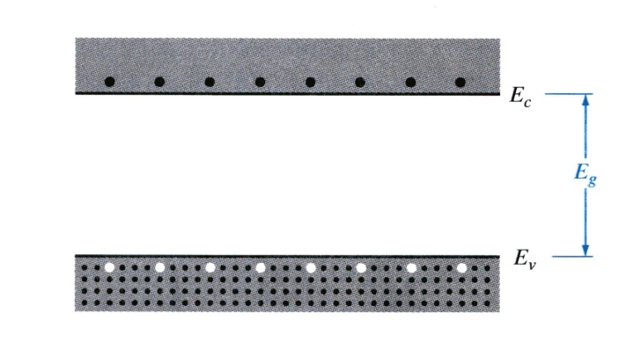
Charge Carriers in Semiconductors
Electrons and Holes
E_{c}→ the bottom of the conduction band
E_{v}→ the top of the valence band
EHP→ an electron-hole pair
At 0K, a semiconductor is an insulator with no free charge carriers
At T > 0K, some electrons in the valence band are excited to the conduction band
The electrons in the conduction band are free to move about via many available states
An empty state in the valence band is referred as a hole

Slide 22
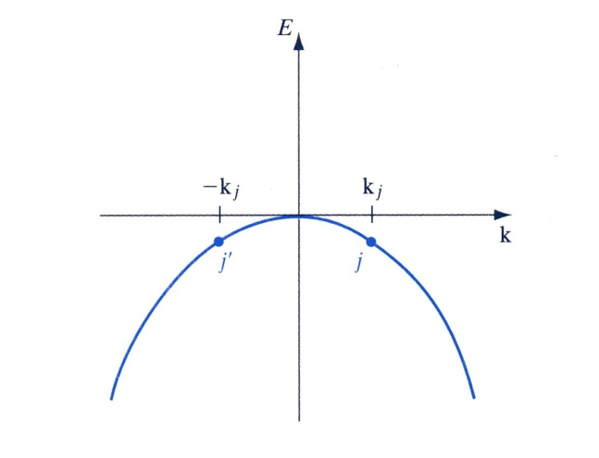
The concept of hole
The total current in a volume with N electrons
The total current with the jth electron missing
A valence band (E vs k ) diagram
with all states filled
The net result: a positive charge moving with velocity v_{j}
A hole is an imaginary positive charge moving in the valence band
The energy of a hole increases downward in a normal band diagram
The total current flow in a semiconductor is the sum of electron current and hole current

Slide 23
Effective Mass
—The effective mass of an electron in a band with a given (E, k) relationship is defined as
(3-3)
For free electrons,
→ m* = m
The effective mass is inversely proportional to the curvature of the band
The electrons near the top of the valence band have negative effective mass
In general m* is different in each direction and is a tensor; appropriate averages are
needed for various calculation purposes (e.g. density of state effective mass vs
conductivity effective mass, section 3.4.1)
The introduction of m* will simplify calculations
electron effective mass is denoted by m_{e}* ; hole effective mass is denoted by m_{e}*

Slide 24
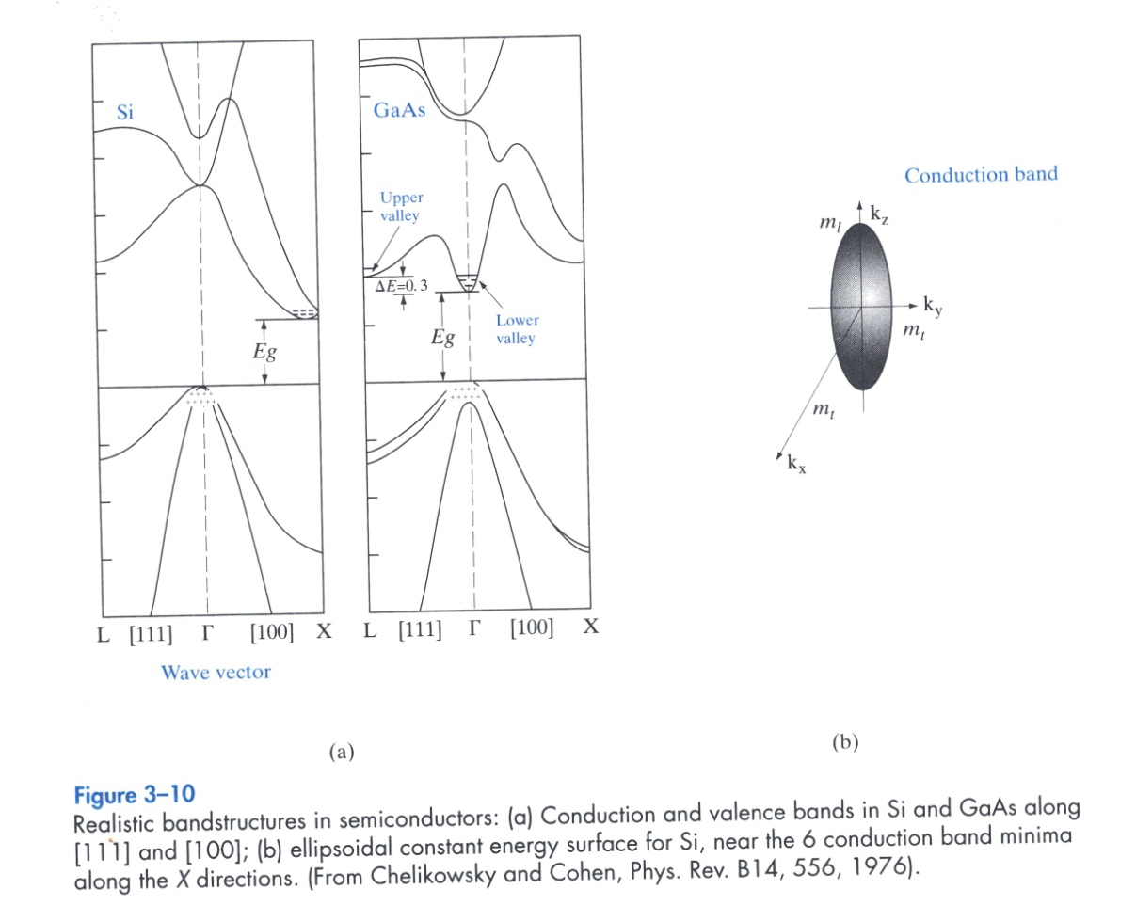
Realistic Band Structures in Semiconductors
GaAs is a direct semiconductor
For holes we have light hole band, heavy hole band and split-off band
Si is an indirect semiconductor
Si has six equivalent conduction band minima at X along six
equivalent <100> directions
The constant energy surface for silicon in one of the six conduction bands is a ellipsoid
m_{l} is the longitudinal effective mass
m_{t} is the traverse effective mass

Slide 25
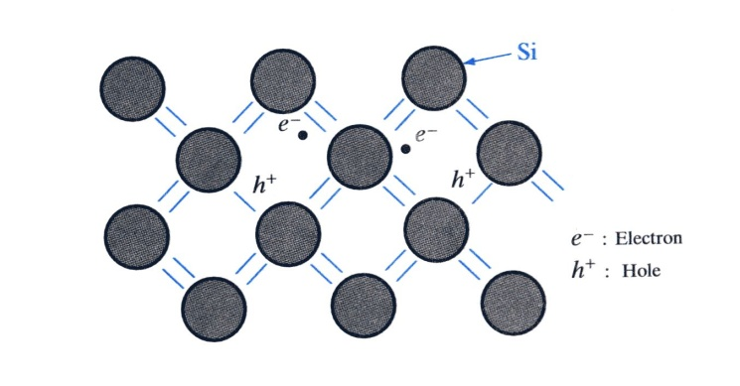
Intrinsic Semiconductor
—a perfect semiconductor crystal with no impurities or lattice defects
n → conduction band electron concentration
(electrons per cm³)
p → valence band hole concentration
n=p=n_{i}
(3-6)
r_{i} → recombination rate of EHP; g_{i} → generation rate
n_{0 ,} p₀ → concentrations at equilibrium; α_{r} → constant
r_{i}=α_{r}n₀p₀ = α_{r}n_{i}² =g_{i}
(3-7)
EHP generation in an
intrinsic semiconductor

Slide 26
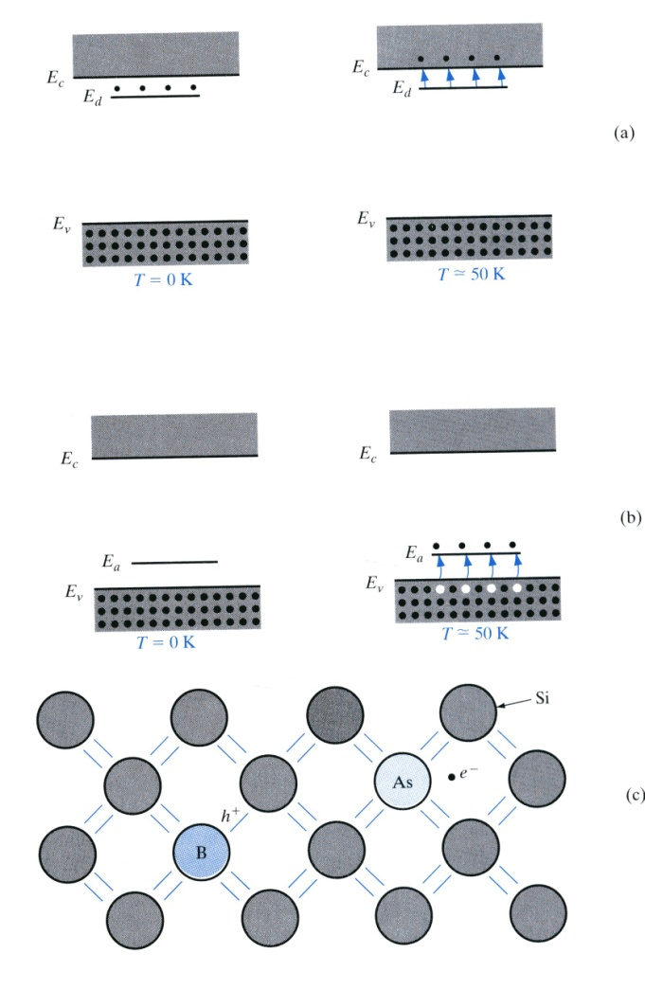
Extrinsic Semiconductor
→ a doped semiconductor crystal whose equilibrium carrier concentrations n₀ and
p₀ are different from the intrinsic carrier concentration n_{i}
The consequences of doping
new donor or acceptor levels are created in the band gap
conductivities can be vastly increased
(n₀ or p₀ >> n_{i} )
semiconductor becomes either n-type or p-type
(either n₀ >> p₀ or p₀ >> n₀ )
For Si and Ge
Group V elements such as As, P, Sb are donor impurities
Group III elements such as B, Al, Ga and In are acceptor impurities

Slide 27
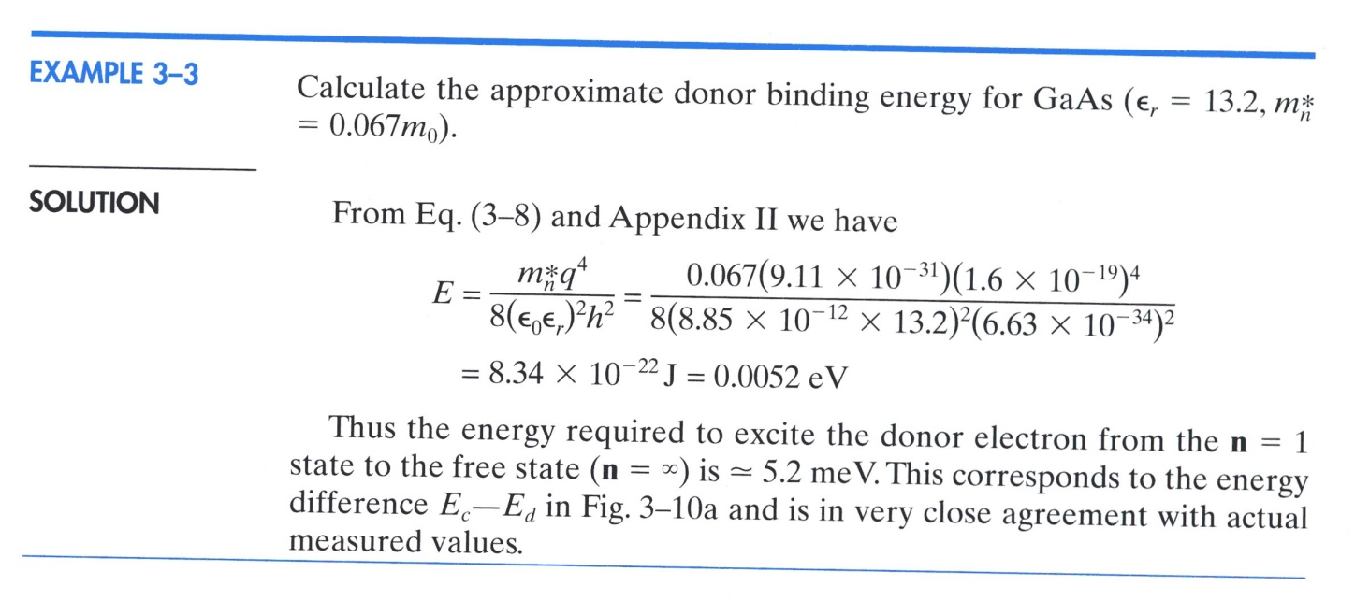
The donor binding energy for GaAs—an example
From Bohr model, the ground state energy of an “extra” electron of the donor is
(3-8)
Compare with the room temperature (300K) thermal energy E=kT≈26meV
All donor electrons are freed to the conduction band (ionized)
Compare with the intrinsic carrier concentration in GaAs (n_{i}=1.1 x 10⁶ /cm³)
We will have an increase in conduction electron concentration by 10¹⁰ if we dope
GaAs with 10¹⁶ S atoms/cm³

Slide 28
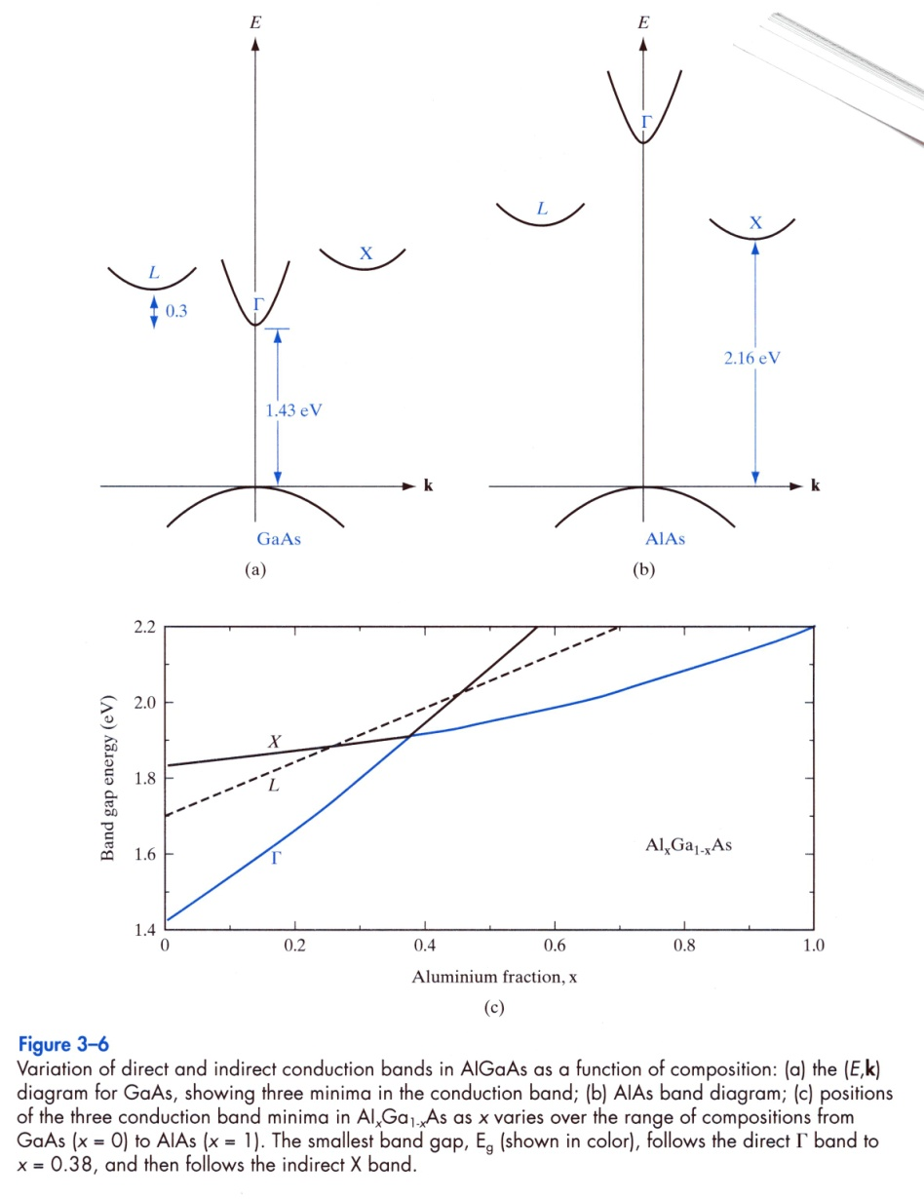
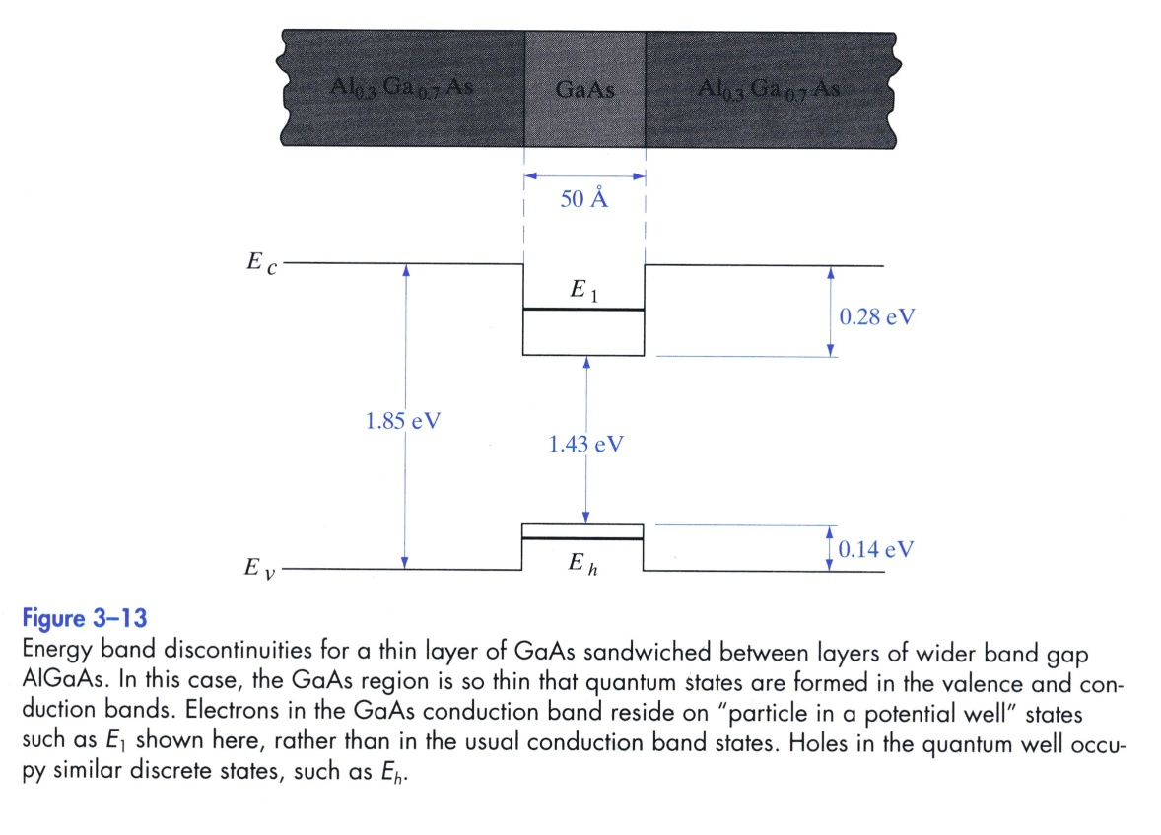
“Band Gap Engineering” ( 3.1.5 & 3.2.5 )

